Slide 1


Slide 2
Review Chap-3 Semiconductors

Slide 3
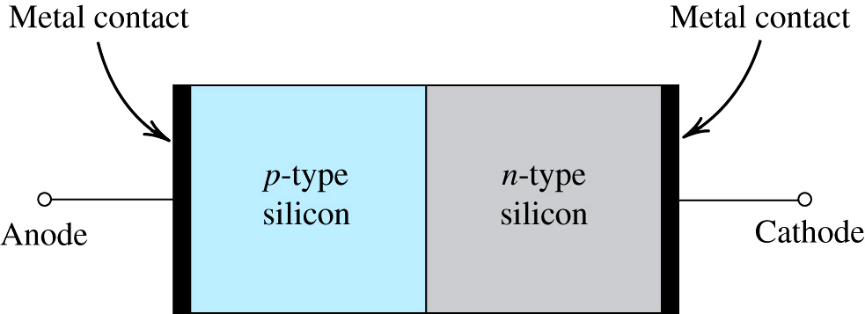
The PN Junction
Simplified physical structure of the pn junction
As the pn junction implements the junction diode, its terminals are labeled anode and cathode

Slide 4
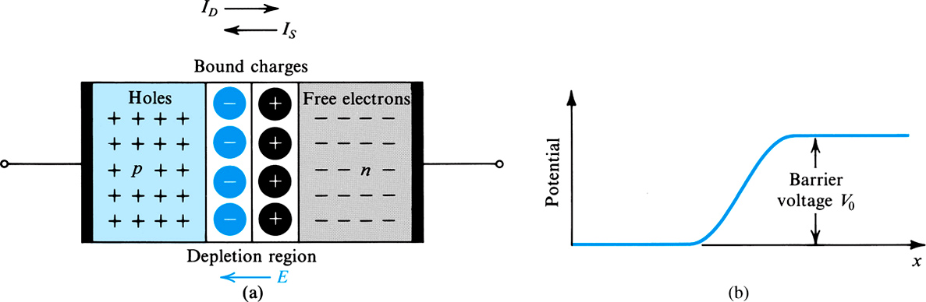
PN Junction with open Circuit Terminals

Slide 5
PN Junction with open Circuit Terminals
I_{D} is the diffusion current
I_{S} is the drift current
In the depletion region holes and electron recombine, thus no free charge carrier
Positive charge on the N-side and negative on the P-side of the junction cause a barrier voltage across the junction

Slide 6
PN Junction with open Circuit Terminals
The drift current I_{S} is due to minority carrier
Electrons in the p-material at the edge of depletion region are swept into the n-side under the effect of electric field in the depletion region
Holes from n-material are swept into the p-side
Under the equilibrium condition I_{D} = I_{S}
The barrier voltage V_{o} is given by:

Slide 7
PN Junction with open Circuit Terminals
For silicon at room temperature, V_{o} is in the range of 0.6 to 0.9 volts
Dependence on temperature ???

Slide 8
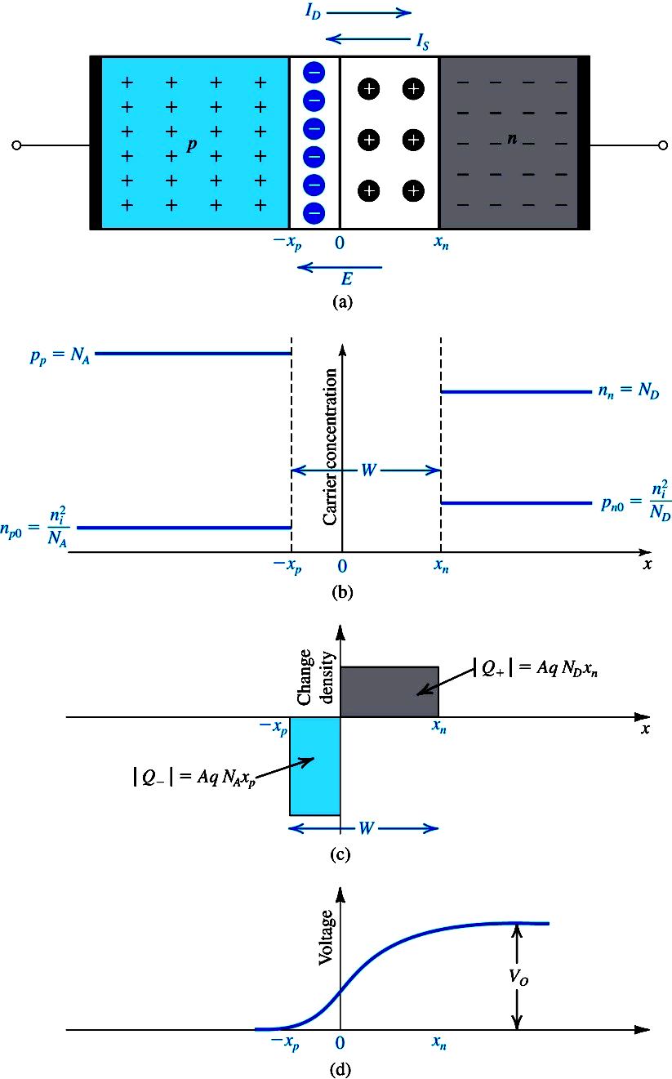
Width of, and Charge Stored in the Depletion Region
The depletion layer extends in both the p and n materials
Equal amounts of charge exist on both sides
Width of depletion layer on either side depends on doping level. It will extend deeper into the lightly doped material.
In the figure n-type material is lightly doped as compared to p-type
(N_{A} > N_{D})

Slide 9
Width of, and Charge Stored in the Depletion Region

Slide 10
Width of, and Charge Stored in the Depletion Region

Slide 11
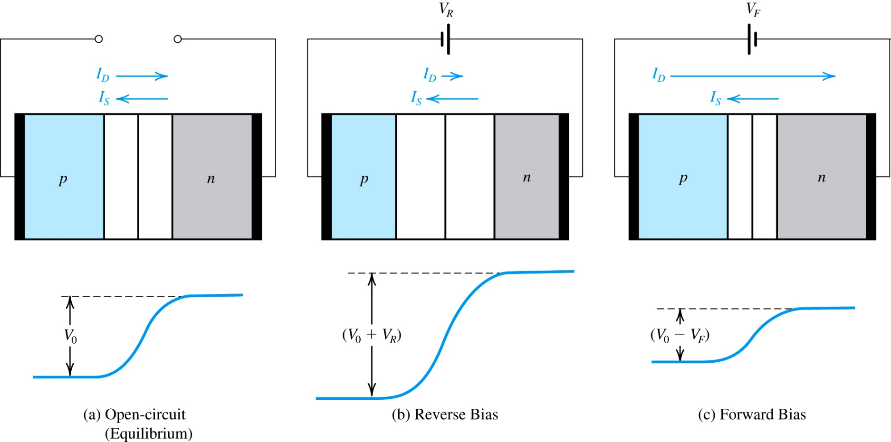
PN Junction with an Applied Voltage

Slide 12
EE-215 Lectures
Electronic Devices & Circuits
Text Book: Chapter 04 (Sedra/Smith 6th Ed)
Diodes
4.1 Ideal Diode
4.1.1 Current–Voltage Characteristic
4.1.2 A Simple Application: The Rectifier
4.1.3 Diode Logic Gates
Instructor: Shakeel Alvi
Class: BEE 12 C&D
Electrical Engineering Department

Slide 13
1. The characteristics of the ideal diode and how to analyze and design circuits containing multiple ideal diodes together with resistors and dc sources to realize useful and interesting nonlinear functions.
2. The details of the i–v characteristic of the junction diode (which was derived in Chapter 3) and how to use it to analyze diode circuits operating in the various bias regions: forward, reverse, and breakdown.
3. A simple but effective model of the diode i–v characteristic in the forward direction; the constant-voltage-drop model.
4. A powerful technique for the application and modeling of the diode (and in later chapters, transistors): dc-biasing the diode and modeling its operation for small signals around the dc operating point by means of the small-signal model.

Slide 14
5. The use of a string of forward-biased diodes and of diodes operating in the breakdown region (zener diodes), to provide constant dc voltages
(voltage regulators).
6. Application of the diode in the design of rectifier circuits, which convert ac voltages to dc as needed for powering electronic equipment.
7. A number of other practical and important applications of diodes.

Slide 15
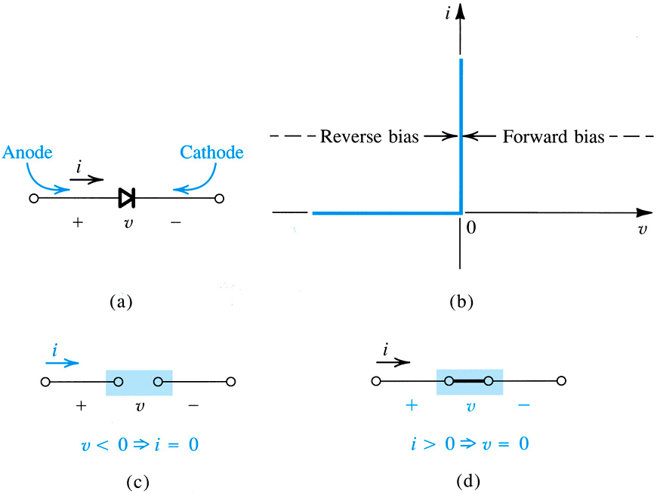
Current-Voltage Characteristic of Ideal Diode
What will be the relationship between current and voltage

Slide 16
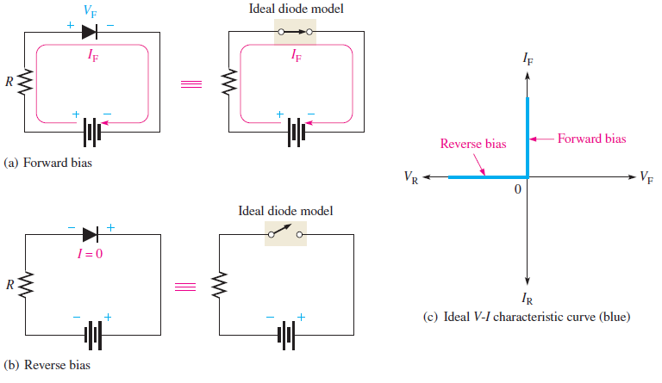
Ideal Diode Characteristics

Slide 17
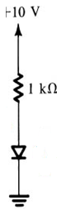
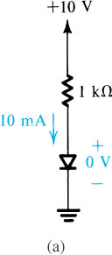
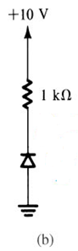
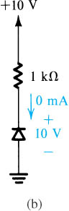
(a) In this circuit the diode is forward biased, meaning it will be short-circuited , so the dc source is shorted through a 1 k Ohm resistor . The current through the circuit is 10 m A
(b) In this circuit the diode is reversed biased, meaning it will be open-circuited , so there is no current flow through the circuit
Notes:
sedr42021_0302a.jpg

Slide 18
We saw the V-I characteristics of an Ideal Diode What are its input/ output characteristics?

Slide 19
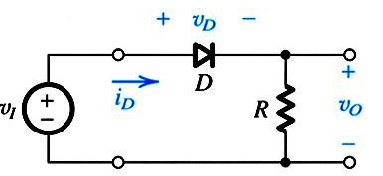
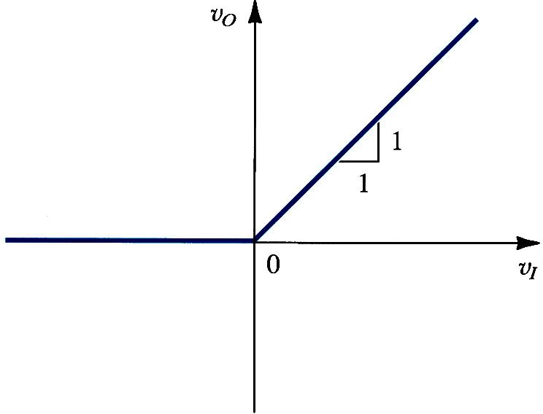
The Rectifier: v_{O} versus v_{I} Graph
No change
In this case what is the effect on slope of the line if R is increased
Output is following the input in positive half cycle

Slide 20
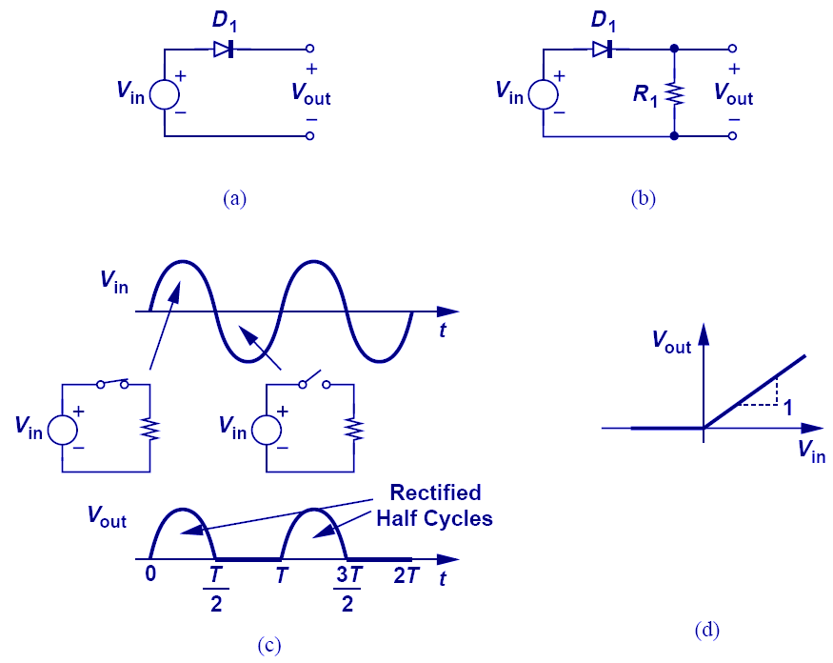
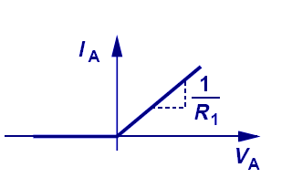
DIODE Circuit: Input / Output Characteristics
in
In this case what is the effect on slope of the line if R is increased

Slide 21
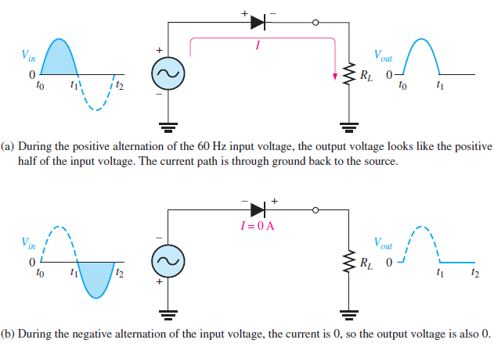
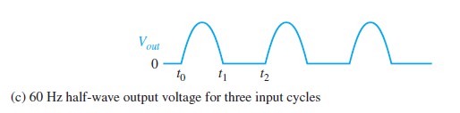
Half-wave Rectifier
Did this rectifier satisfied the input / output characteristics ?

Slide 22
What will be the output if we take output across the diode

Slide 23
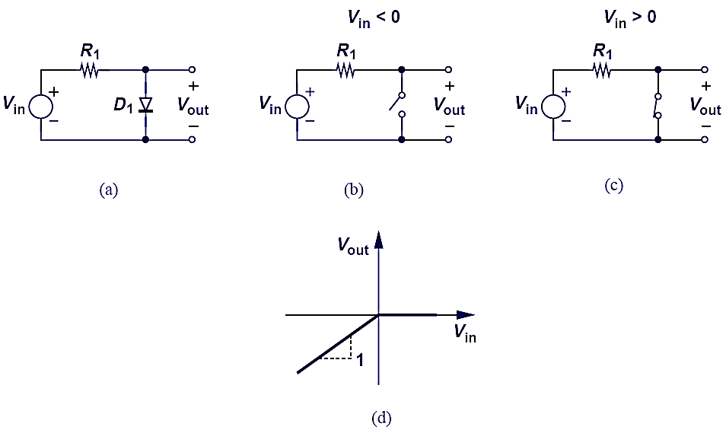
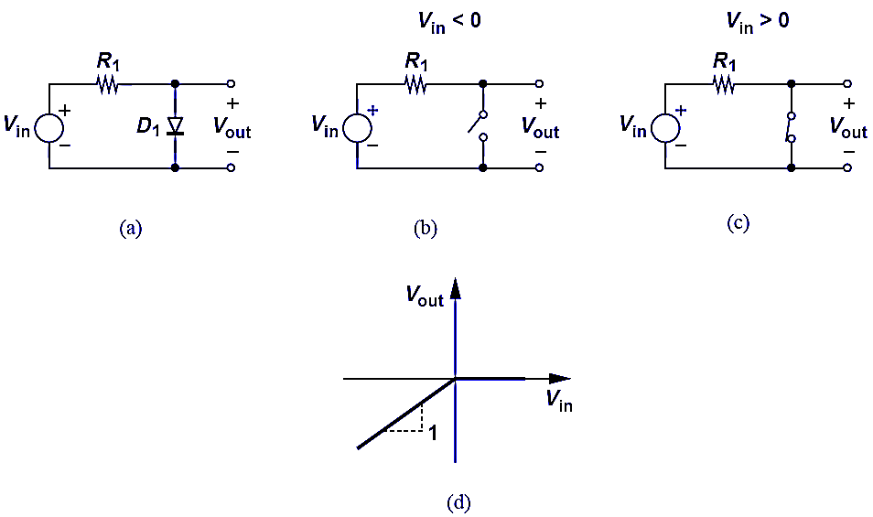
DIODE Circuit: Input / Output Characteristics

Slide 24
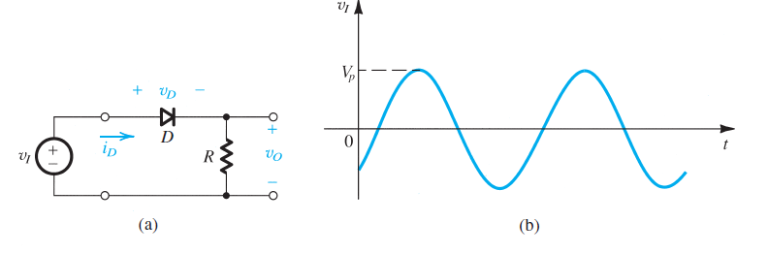
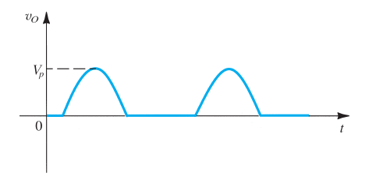
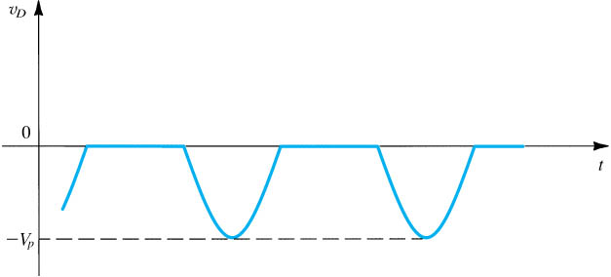
Signal at the resistance R
Signal at the Diode
Notes:
sedr42021_e0302.jpg

Slide 25
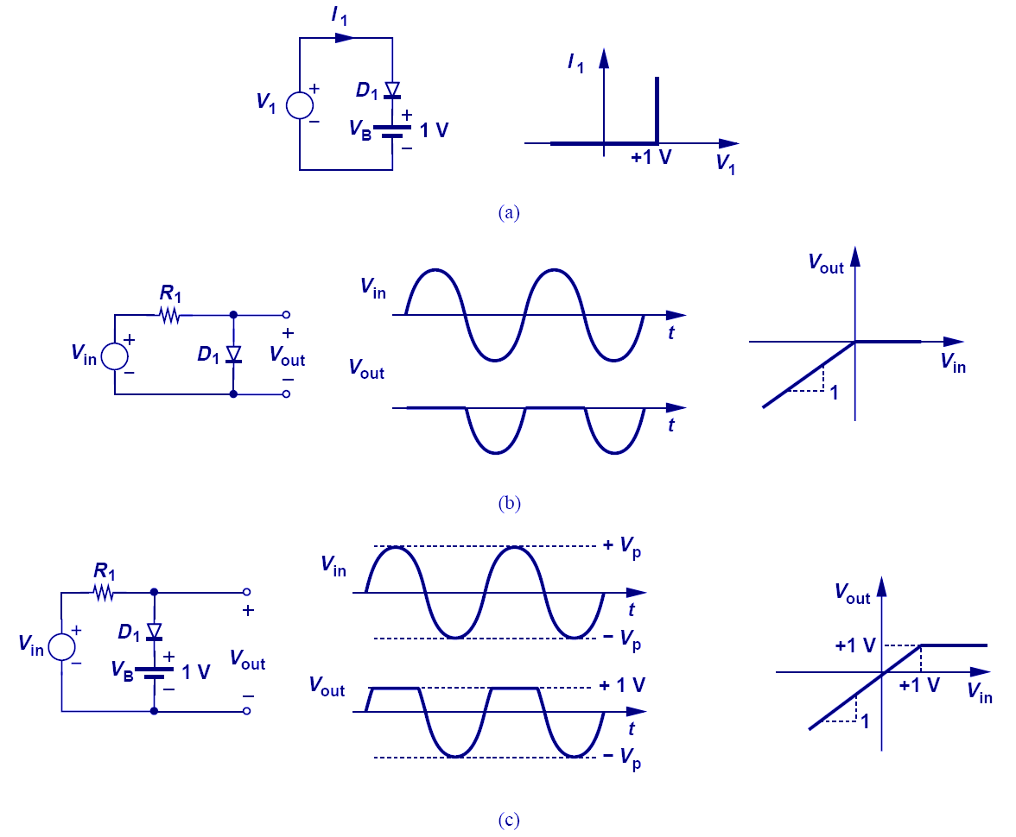
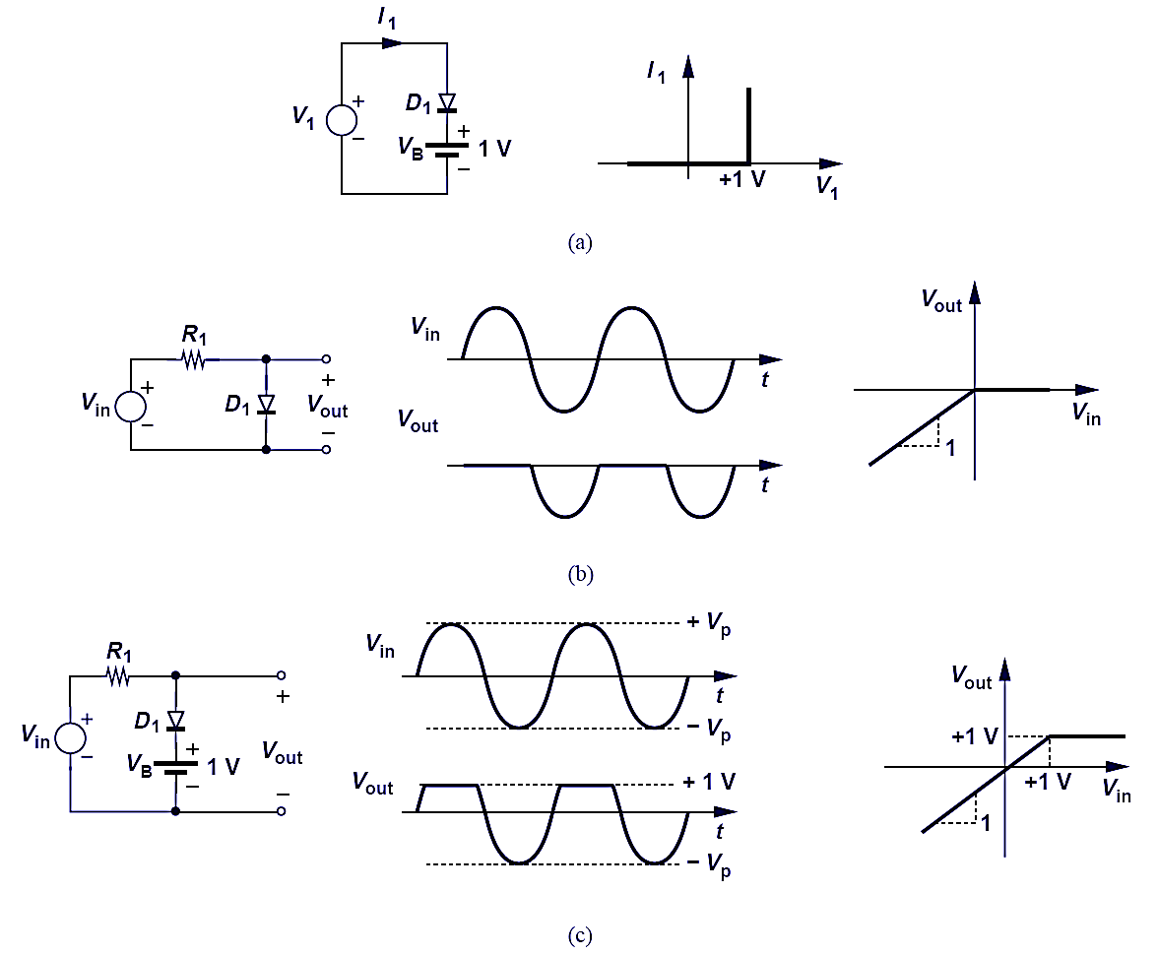
DIODE Circuit: Input / Output Characteristics
Why the curve shifts upwards ?????

Slide 26
What will be the V-I Characteristics

Slide 27
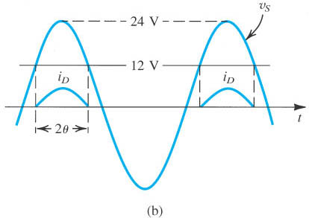
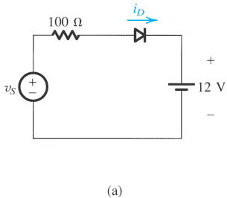
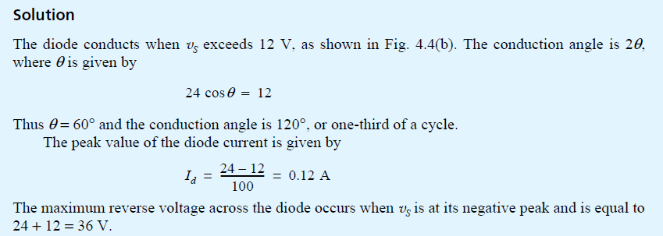
Example from text book
Notes:
sedr42021_0304a.jpg

Slide 28
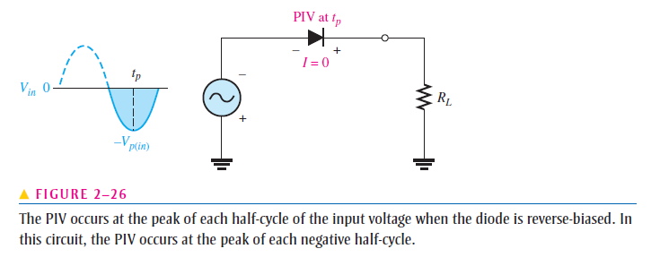
Care for reverse –bias voltage(PIV) in the circuit design
We are controlling max forward current using external resister ,
but are we catering for max reverse bias voltage ?

Slide 29
Average Values

Slide 30
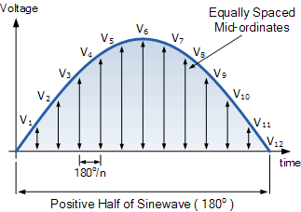
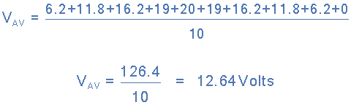
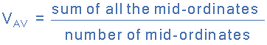
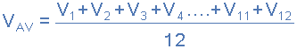
The Graphical Method
Voltage | 6.2V | 11.8V | 16.2V | 19.0V | 20.0V | 19.0V | 16.2V | 11.8V | 6.2V | 0V
Angle | 18º | 36º | 54º | 72º | 90º | 108º | 126º | 144º | 162º | 180º

Slide 31
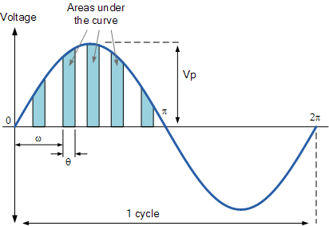

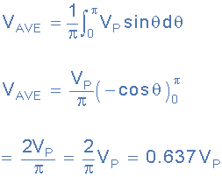
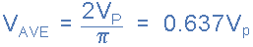
Analytical Method
Average Voltage Equation

Slide 32
The main differences between an RMS Voltage and an Average Voltage, is that the mean value of a periodic wave is the average of all the instantaneous areas taken under the curve over a given period of the waveform, and in the case of a sinusoidal quantity, this period is taken as one-half of the cycle of the wave. For convenience the positive half cycle is generally used.
The effective value or root-mean-square (RMS) value of the waveform is the effective heating value of the wave compared to a steady DC value and is the square root of the mean of the squares of the instantaneous values taken over one complete cycle.
For a pure sinusoidal waveform ONLY, both the average voltage and the RMS voltage (or currents) can be easily calculated as:
Average value = 0.637 × maximum or peak value, Vpk
RMS value = 0.707 × maximum or peak value, Vpk

Slide 33
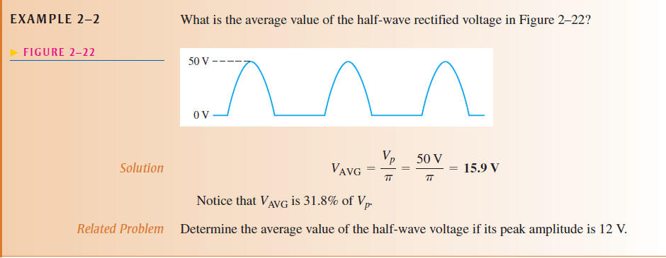
Example

Slide 34
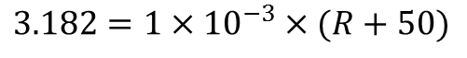
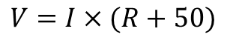
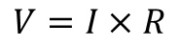
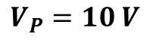
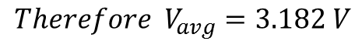
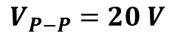
A volt meter utilizes a moving coil meter that gives full scale reading when the average current flowing through it is 1 mA . The moving coil has a 50-Ὠ resistance find the value of R that results in in meter indication full scale reading when input sine wave voltage is 20v peak to peak
$$V_{P−P}=20 V$$
$$V_{P}=10 V$$
But the output from diode will be half-wave rectified
$${Therefore V}_{avg}=3.182 V$$
$$V=I×R$$
$$V=I×(R+50)$$
$$3.182=1×{10}^{−3}×(R+50)$$
R=3132

Slide 35
In class Practice Questions

Slide 36
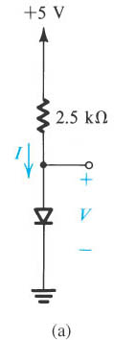
Practice Question 1
Notes:
sedr42021_e0304a.jpg

Slide 37
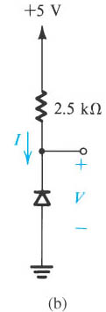
Practice Question 2

Slide 38
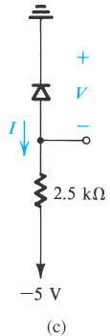
Practice Question 3

Slide 39
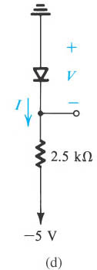
Practice Question 4

Slide 40
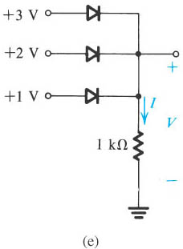
Practice Question 5

Slide 41
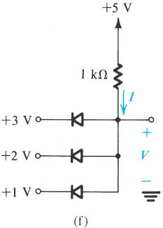
Practice Question 6

Slide 42
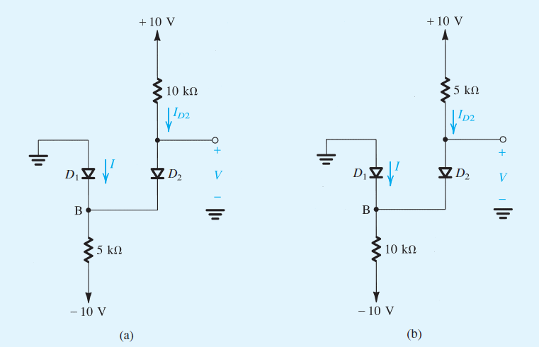
Example
Assuming Ideal Diode find I and V in the circuit

Slide 43
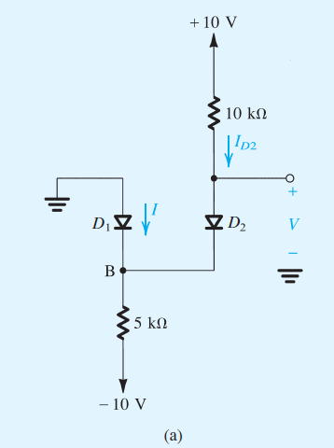
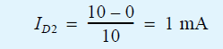

In these circuits it might be not obvious at first sight whether none, one, or both diodes are conducting . In such a case we take a assumption and proceed with the analysis, and then check whether we end up with a consistent solution. For circuit (a) we shall assume that both diodes are conducting . It follows the VB=0 and V=0 . The current through D2 can now be determined from

Slide 44




For the circuit in Fig B if we assume that both diodes are conducting , then VB =0 and V=0. the current in D2 is obtained from

Slide 45


Logic Gates
How can we make logic gates using diodes?
What are the truth Table for
Three input AND Gate?
Three input OR Gate?
BOOLEAN NOTATION

Slide 46


Diode logic gates
Diode logic gates: (a) OR gate; (b) AND gate (in a positive-logic system).
Notes:
sedr42021_0305a.jpg

Slide 48
EE-215 Lecture
Electronic Devices & Circuits
Text Book: Chapter 04 (Sedra/Smith 6th Ed)
4.2 Terminal Characteristics of Junction Diodes
4.2.1Forward bias region
4.2.2Reverse bias region
4.2.3Break down region
Instructor: Dr. Shakeel Alvi
Class: BEE 12 C & D
Electrical Engineering Department

Slide 49

Simple Resistor in a circuit
What will happen if a battery is connected in the circuit ??

Slide 50
Ideal Diode

Slide 51
Gradually moving towards reality

Slide 52

Taking into account the barrier voltage

Slide 53

MORE: Input / Output Characteristics

Slide 54

MORE: Input / Output Characteristics (Study and understand )
Constant voltage drop

Slide 55
Try it yourself

Slide 56

Effect of barrier potential

Slide 57

Draw the out put of each rectifier circuits shown below
When we should cater for this drop in our calculations

Slide 58

Example: Rectifier with a step down transformer

Slide 59
Review
SNo | v | I in terms of Is
Temperature Dependency

Slide 60



What is
Review
Observe that in the reverse direction the current saturates at a value equals to – . For this reason is given the name saturation current. As is directly proportional the cross-sectional area A of the junction . Thus another name for is the junction scale current. The typical value of is in range of

Slide 61




Diode V-I Characteristics
-
+

Slide 62

Forward-Bias Region
The forward-Bias or simply forward-region of operation is entered when the terminal voltage V is positive. In the forward region the i-v relationship is closely approximated by
is the saturation current and its values is a strong function of temperature for every 5 Deg. Rise in temperature the value of doubles
It is also dependent on the junction Cross-sectional-Area of diode doubling the area doubles the saturation current

Slide 63
Forward-Bias Region

Slide 64
Forward-Bias Region

Slide 65
Using I-V Relationships
Thus for a decade change in current, the voltage drop across the diode will change by 2.3 V_{T}
Notes:
acr

Slide 66
Example 4.3
A silicon diode said to be I mA device displays a forward voltage of 0.7 V at a current of 1 mA.
Evaluate the junction scaling constant I_{S}.
What scaling constant would apply for a 1-A diode of the same manufacture that conducts 1 A at 0.7 V?
Solution:
The diode conducting 1 A at 0.7 V corresponds to 1000 1-mA diodes in parallel with a total junction area 1000 times greater. Thus the scaling constant I_{S} is also 1000 times greater

Slide 67
115 Or 120 mv , depending upon value of $V_{T}$

Slide 68

Temperature Dependence of diode Forward V-I Characteristics
At a constant current, the voltage drop decreases by approximately 2 mV for every 1°C increase in temperature.

Slide 69
Saturation and Leakage current
When a semiconductor device is reversed biased it should not conduct any current at all, however, due to increased barrier potential, the free electrons on p side are dragged towards positive while holes on n side are dragged towards negative of the battery this current flows due to minority charge carriers and hence its magnitude is very very small. For constant temperature reverse current is almost constant though applied reverse voltage is increased up to certain limit. Hence it is also called as reverse saturation current.
Diode reverse current is made up of reverse saturation current (I_{S}) and surface-leakage current (I_{SL}). I_{S} is temperature dependent and relatively independent of reverse voltage. I_{SL} is affected by the magnitude of reverse voltage and is relatively independent of temperature.

Slide 70
The Reverse-Bias Region
Real diode reverse currents are much larger than I_{S}.
For small signal diode, whose I_{S} is of the order of 10⁻¹⁴ to 10⁻¹⁵, reverse current could be of the order of 1 nA
The increase in reverse current is due to leakage effects
Increases with increase in reverse voltage
Doubles with every 10ºC rise in temperature
Used in design of electronic thermometer
If v is negative and a few times larger than V_{T} , the exponential term becomes negligible.
The diode current becomes

Slide 71

Workout on your own, no need for submission
Notes:
sedr42021_e0309.jpg

Slide 72
Next Topic
4.3 Modeling the diode forward Characteristics
4.3.1 The Exponential model
4.3.2 Graphical analysis of using exponential model
4.3.3 Iterative analysis using exponential model

Slide 73



Modeling the diode forward Characteristics
Introduction
The most accurate description of the diode operation in the forward region is provided by the exponential model
However, its severely nonlinear nature makes this model the most difficult to use
Assuming that VDD is greater than 0.5 V or so, the diode current will be much greater than IS , and we can represent the diode i–v characteristic by the exponential relationship, resulting in
Eq.1
The other equation that governs circuit operation is obtained by writing a Kirchhoff loop equation, resulting in
Eq. 2

Slide 74
Exponential Model
The exponential model equations can be solved by
Graphical analysis
Iterative analysis

Slide 75

The Exponential Model
The most accurate model
For V_{DD} > 0.5 V, the diode equation may be written as:
Kirchhoff loop equation for the circuit is:
Assume I_{S} is known, we have two variables and two equations

Slide 76



Graphical Analysis
Plot the two equations on the i-v plane
Coordinates of the intersection is the solution set
The load line
$$I_{D=0, when V_{D}=V_{DD}}$$
$$I_{D}=\max{ }when V_{D}=0$$

Slide 77
The Load for a Diode in a circuit

Slide 78
Iterative Analysis

Slide 79
Example 4.4
Determine the current I_{D} and the diode voltage V_{D} for the circuit in the figure with V_{DD} = 5 V and R = 1 kΩ. Assume the diode has a current of 1 mA at a voltage of 0.7 V.
Solution:
Assume that V_{D} = 0.7 V to determine the current

Slide 80

The Constant-Voltage-Drop Model
The simplest and most widely used model
The forward bias diode has voltage drop with little variation around 0.7 V
The voltage drop is assumed constant at 0.7 V
the exponential characteristic
approximating the exponential characteristic by a constant voltage, usually about 0.7 V_{i}
model of the forward–conducting diodes

Slide 81

Repeating previous example
The values are not far from more elaborate models, so for quick analysis this model can be employed

Slide 82

Ideal Diode Model
In applications that involves voltages much greater then diode voltage drop of 0.6-0.8 volts, we may neglect the diode voltage drop altogether while calculating the diode current. This results in ideal diode model.
Which for a very quick analysis would not be bad as a gross estimate. However with almost no additional work the 0.7 volt drop model yields much more realistic results

Slide 83
Small Signal Model
There are applications in which a diode is biased to operate at a point on forward i-v characteristic and a small ac signal is superimposed on the dc quantities.
For this situation we first determine the dc operating point of the diode using any of the model, mostly constant voltage drop model is utilized.
Then for a small signal operation around the dc bias point, the diode is modeled by a resistance equal to inverse of the slope of the tangent to the exponential i-v characteristic at the bias point

Slide 84


The Diode Small Signal Model

Slide 85
Small Signal Analysis

Slide 86
Small Signal Analysis (cont’d)

Slide 87


Incremental Resistance

Slide 88
Conclusion
Superimposed on the quantities VD and ID, that define the dc bias point, will be small signal quantities and , which are related by the diode small signal resistance evaluated at the bias point.
Thus small signal analysis can be performed separately from the dc bias analysis, because of linearization of the diode characteristics inherent in the small signal approximation.
Specifically after the dc analysis is performed, the small signal equivalent circuit is obtained by eliminating all dc sources and replacing diode by a small signal resistance.

Slide 89



Equivalent circuits

Slide 90

Example 4.5
Consider the circuit shown in the figure for the case in which R = 10 KΩ . The power supply V⁺ has a dc value of 10 V on which is superimposed a 60-Hz sinusoid of 1 -V peak amplitude. Calculate both the dc voltage of the diode and the amplitude of the sine-wave signal appearing across it.
Assume the diode to have a 0.7-V drop at 1-mA current.
This "signal" component of the power-supply voltage is an imperfection in the power-supply design. It is known as the power-supply ripple.
Solution:
Considering dc quantities only: assume V_{D} = 0.7 V
(Very close to 1 mA)
The DC operating point is (0.7 V, 0.93 mA)

Slide 91
Solution:
Considering dc quantities only: assume V_{D} = 0.7 V
(Very close to 1 mA)
The DC operating point is (0.7 V, 0.93 mA)
The diode incremental resistance r_{d} is:
The signal voltage across the diode can be found from the small-signal equivalent circuit

Slide 92
Use of the diode forward drop in voltage regulation

Slide 93

Example 4.6
Consider the circuit given below. A string of three diodes is used to provide a constant voltage of about 2.1V . We want to calculate the percentage change in this regulated voltage caused by:
A +/- 10% change in power supply voltage
Connection of a 1-Kohm load.

Slide 94







Slide 95

EXAMPLE -1 SOLVED IN CLASS

Slide 96

EXAMPLE -2 SOLVED IN CLASS

Slide 97


Home Assignment

Slide 99


Model for the zener diode.
Notes:
sedr42021_0322.jpg

Slide 100
Model: Zener

Slide 101

Designing of the Zener shunt regulator
+
Supply voltage includes
a large ripple component
V_{o}
-
Zener regulator
Vo is an output of the zener regulator
that is as constant as possible in spite of
the ripples in the supply voltage V_{S}
and the variations in the load current
Voltage regulator performance can be measured
Line Regulation & Load Regulation
Line Regulation = ΔV_{o}/ΔV_{s}
Load Regulation = ΔV_{o}/ΔI_{L}

Slide 102


Our area of interest
The Zener Diode
Circuit symbol
Specially designed to operate in the breakdown region
The zener voltage V_{Z} is specified at a specified test current I_{TZ}
Deviation from I_{TZ} causes small variation in V_{Z}
r_{z} is the incremental resistance (dynamic resistance)

Slide 103

The Zener Diode: Equivalent Circuit

Slide 104


Zener Diode as a Shunt Regulator
Example 4.7
The 6.8-V Zener diode in the circuit shown in the Fig is specified to have V_{Z} = 6.8 V at I_{Z} = 5 mA, r_{z} = 20 Ω, and I_{ZK} = 0.2 mA. The supply voltage V ⁺ is nominally 10 V but can vary by

Slide 105
$$V_{Z} and I_{Z} are given but need to find V_{Z0}$$
$$V_{ZO}=V_{Z}−I_{Z}r_{Z}$$
Substituting the values
$V_{ZO}=6.8−$0.1 = 6.7 volts

Slide 106

Zener Diode as a Shunt Regulator
After calculating the $V_{ZO}$ , We make the equivalent circuit of the zener along with the external elements (Circuits),
Note that the external voltage and the resistor will change $I_{Z}$ , So now we will have to redo the calculations
Zener diode replaced with equivalent circuit

Slide 107




V_{Z} = 6.8 V
I_{Z} = 5 mA
r_{z} = 20 Ω
Line Regulation = ΔV_{o}/ΔV_{s}

Slide 108




Current through zener is reduced by 1 mA
$$∆I_{Z}=\frac{6.8}{2000}=3.4mA$$

Slide 109

The current reduced below
I_{ZK} = 0.2 mA
So not regulating

Slide 110

At the edge of breakdown region
The lowest current through R
The load current is
Min R_{L}

